Slide 1

Application development
Present: Tran Quang Huy

Slide 2
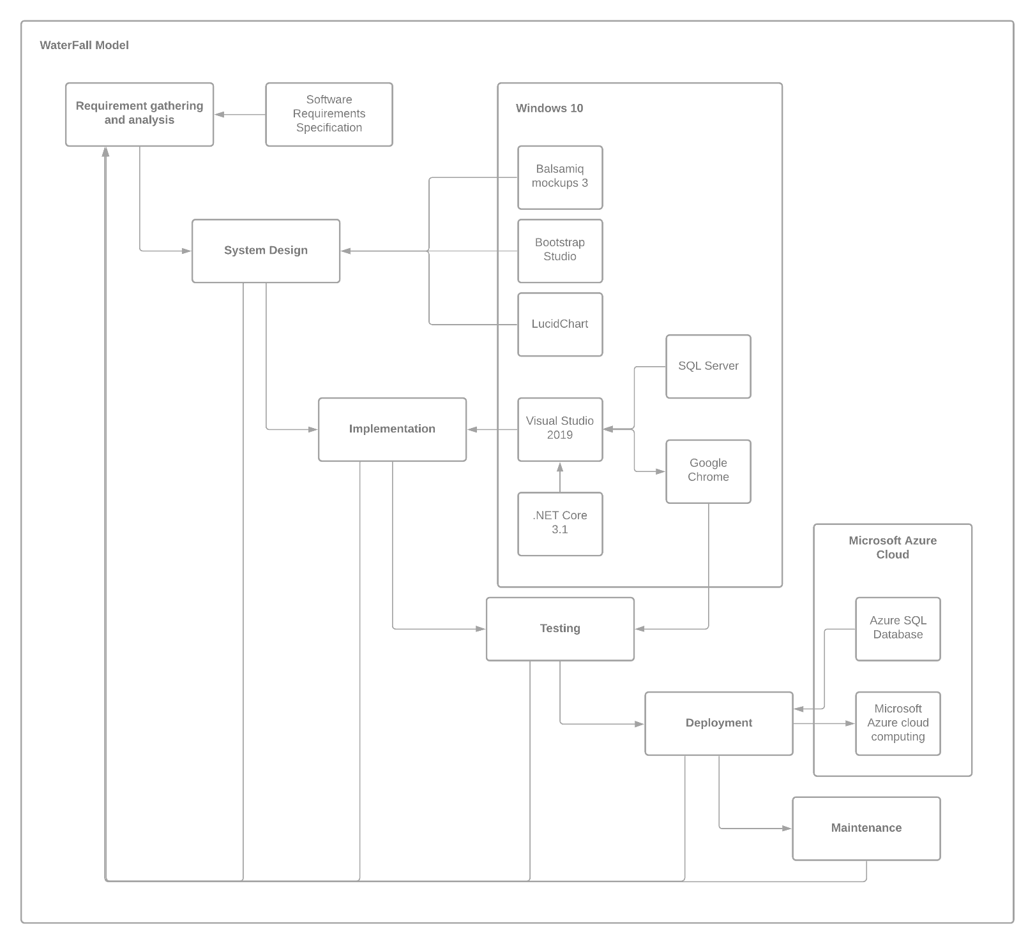
FPT Learning System

Slide 3







Tools
_{Design tool:}
_{Lucidchart}
_{Balsamiq Mockups 3}
_{Boostrap Studio}
_{Web browser:}
_{Google Chrome}
_{Operating system:}
_{Windows 10 Pro}
_{IDE:}
_{Visual Studio 2019}

Slide 4
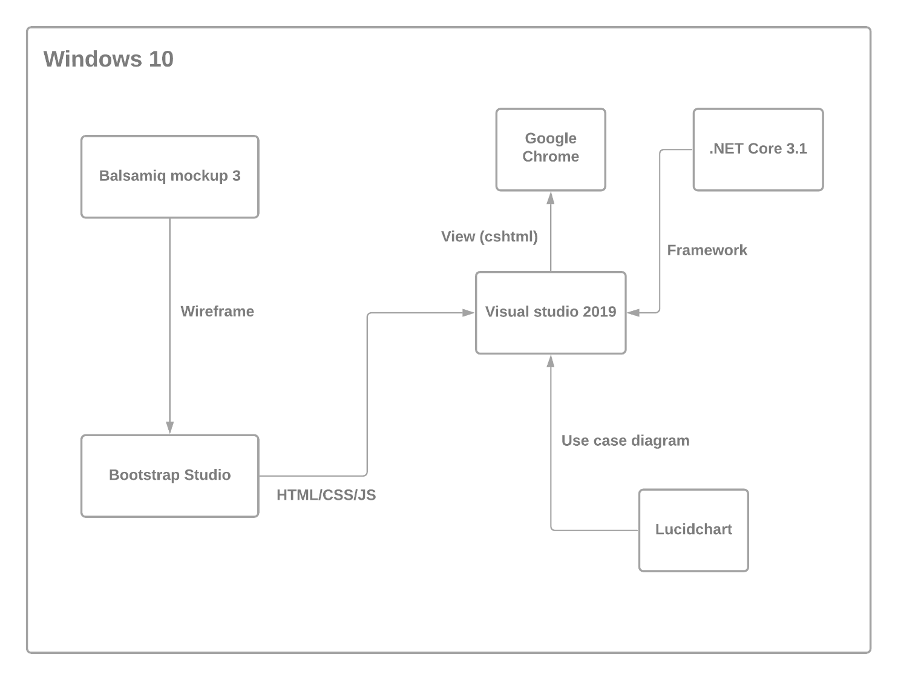
Tools

Slide 5





Framework

Slide 6
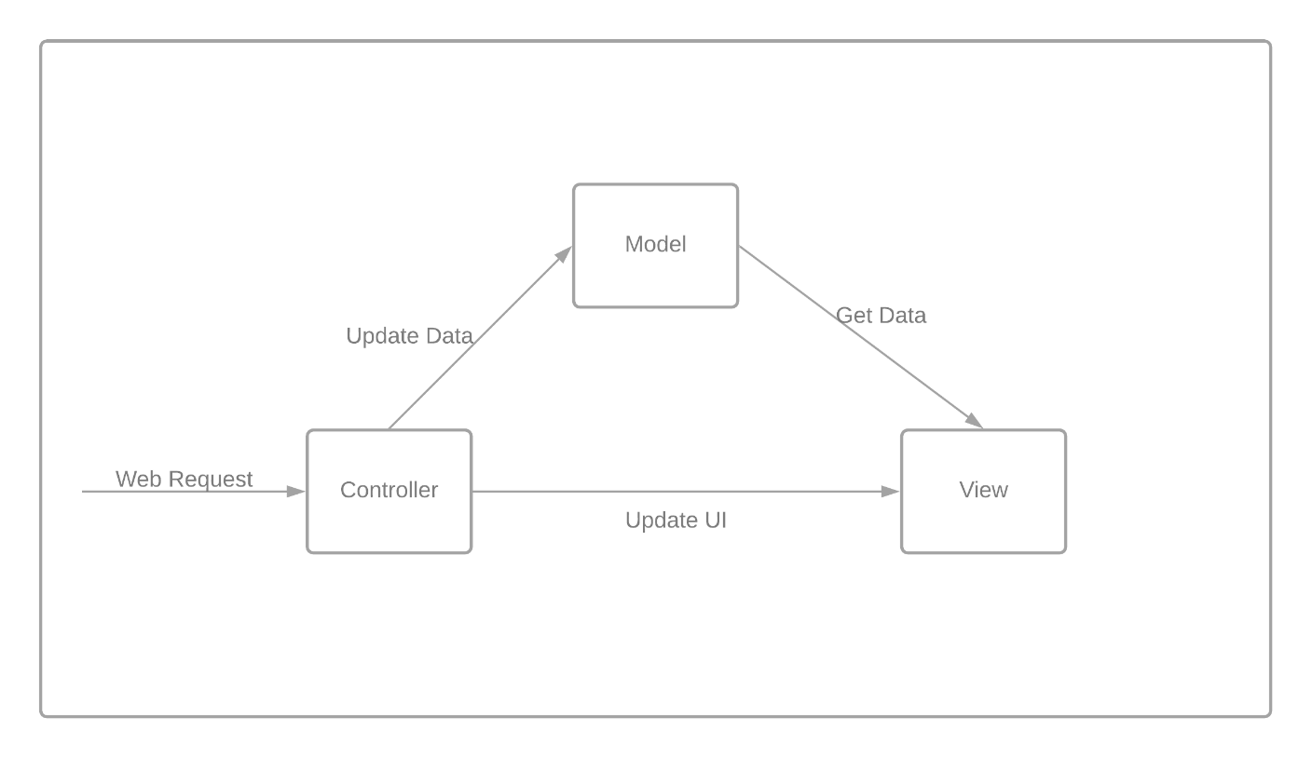
Model MVC

Slide 7



Database
SQL
NoSQL

Slide 8
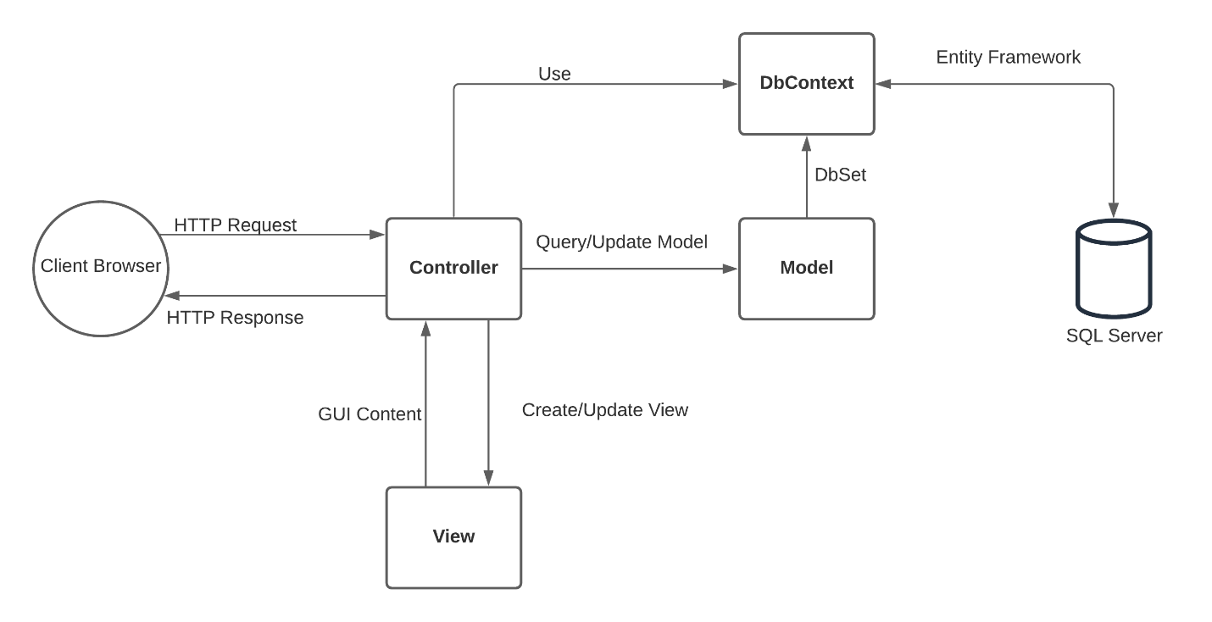
Database

Slide 9




Cloud

Slide 10
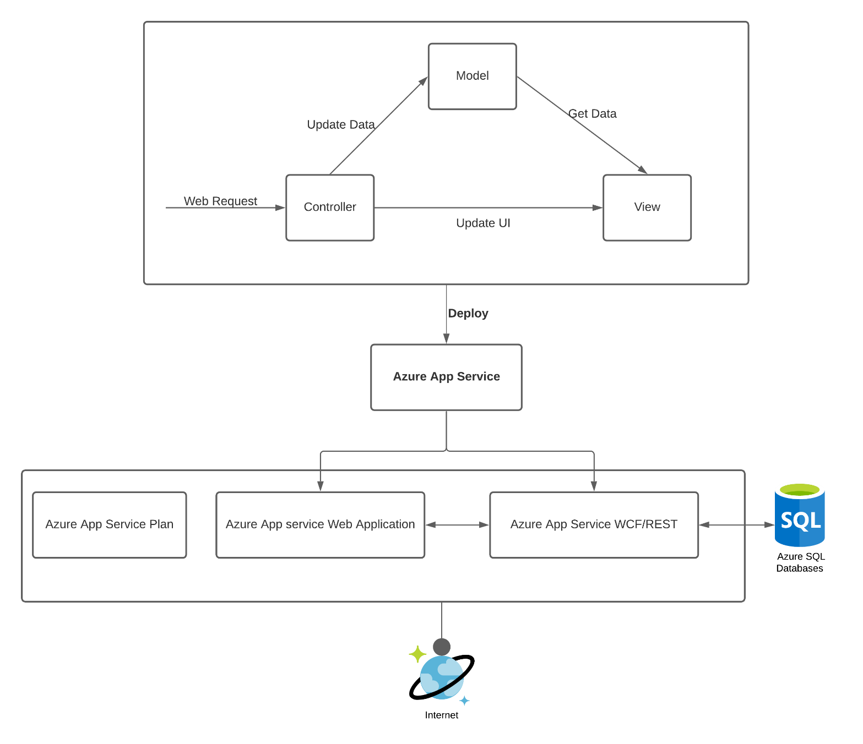
Cloud
Notes:
Windows Communication Foundation

Slide 11
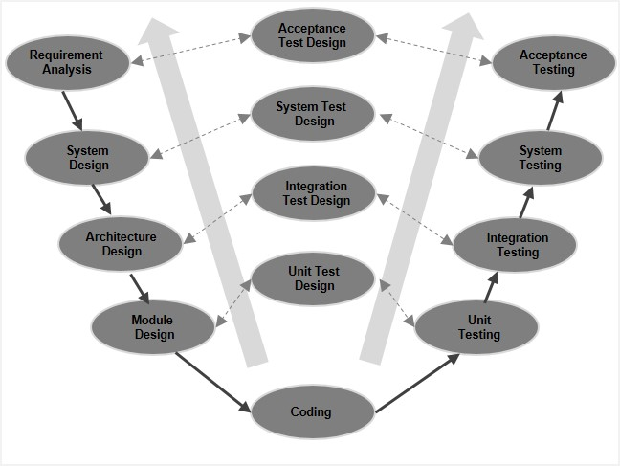
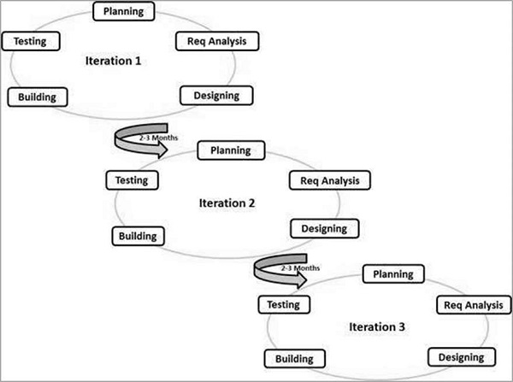
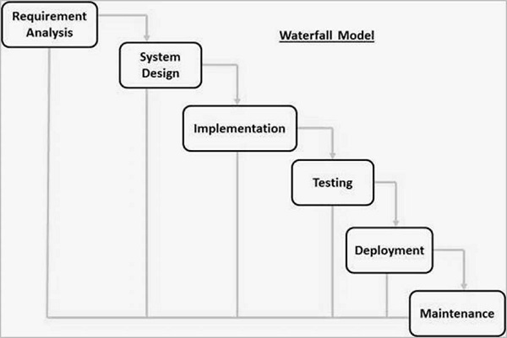
Software Model
Waterfall
V-Model
Agile

Slide 12
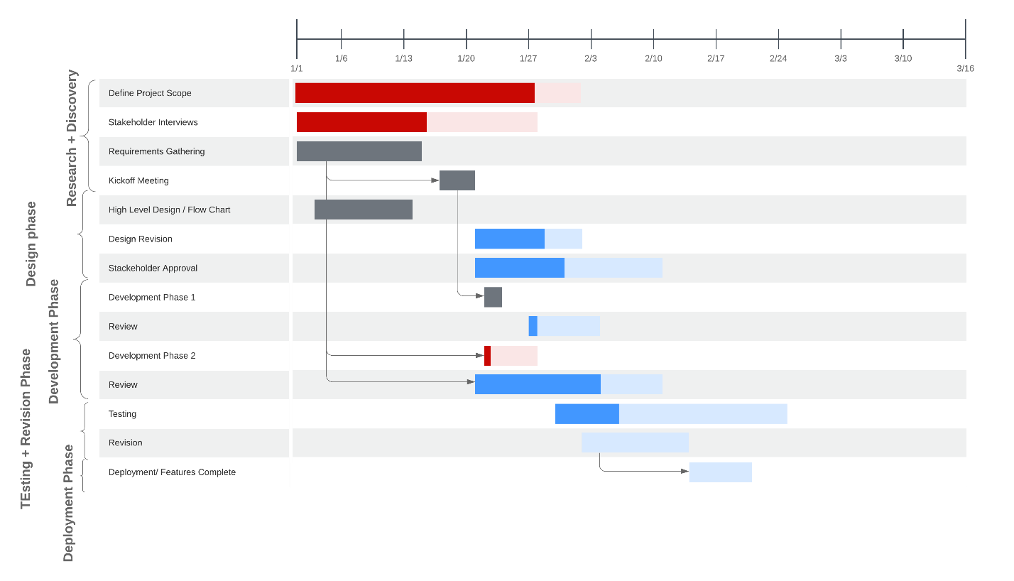
Software Model

Slide 14
THANKS FOR WATCHING
Live demo: https://fptlearningsystem.azurewebsites.net/
Source code: https://github.com/SuperMido/FptLearningSystem

